Slide 1
Flight Fare Predictions
Group 17

Slide 2
Dataset Overview
Kaggle dataset (https://www.kaggle.com/datasets/dilwong/flightprices)
Full dataset contains ~82M data points, which was generally used in entirety
A random sample of ~820k points was used for certain parts of EDA due to computational constraints associated with plotting certain graphs
27 features
16 unique airports

Slide 3
Objective
Purpose
Develop a machine learning model to accurately predict airfare prices.
Utilize a data-driven approach to analyze airfare trends, providing valuable insights for passengers and the airline industry.
Impact
Enhances price prediction accuracy, helping passengers find optimal booking times.
Empowers airlines with data-driven pricing strategies to maximize revenue.
Improves market transparency, reducing uncertainty in airfare fluctuations.
Supports better decision-making for travel planning and budgeting.

Slide 4
Literature Review
Prior Research:
Studies have used ML models like Random Forest, XGBoost, and SVMs to predict airfare with up to 87% accuracy (Tziridis et al., 2017).
Feature engineering—departure time, holidays, stops, and routes—has been key to improving predictions (Biswas et al., 2022).
Some work has focused on purchase timing optimization using regression techniques (Groves & Gini, 2013).

Slide 5
Literature Review Cont’d
Limitations of Existing Work:
Smaller datasets with limited route coverage.
Manually selected features rather than automated feature extraction.
Narrow focus on specific airlines or flight types.
Our Approach:
Uses a large-scale Expedia dataset with diverse routes, fare types, and granular flight details.
Incorporates advanced gradient-boosting models (XGBoost) for handling complex interactions.
Aims for a scalable, dynamic fare prediction model suited for real-world market conditions

Slide 6
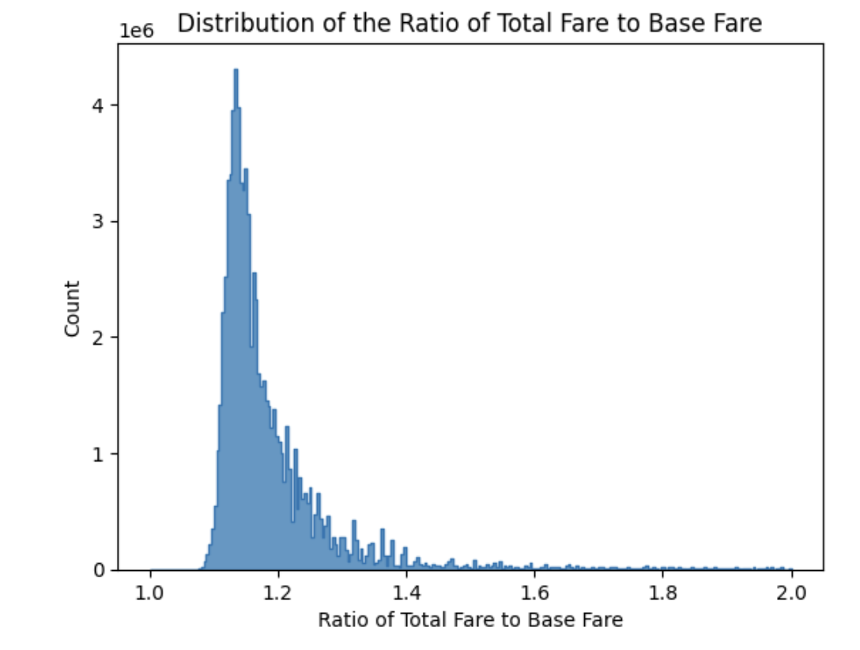
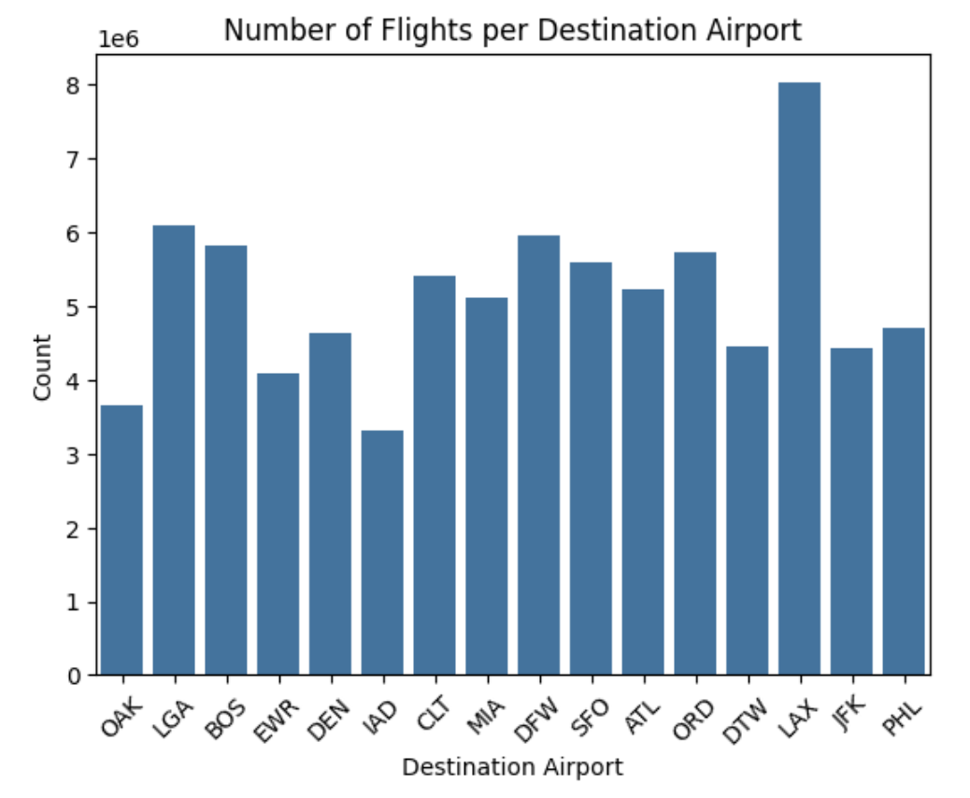
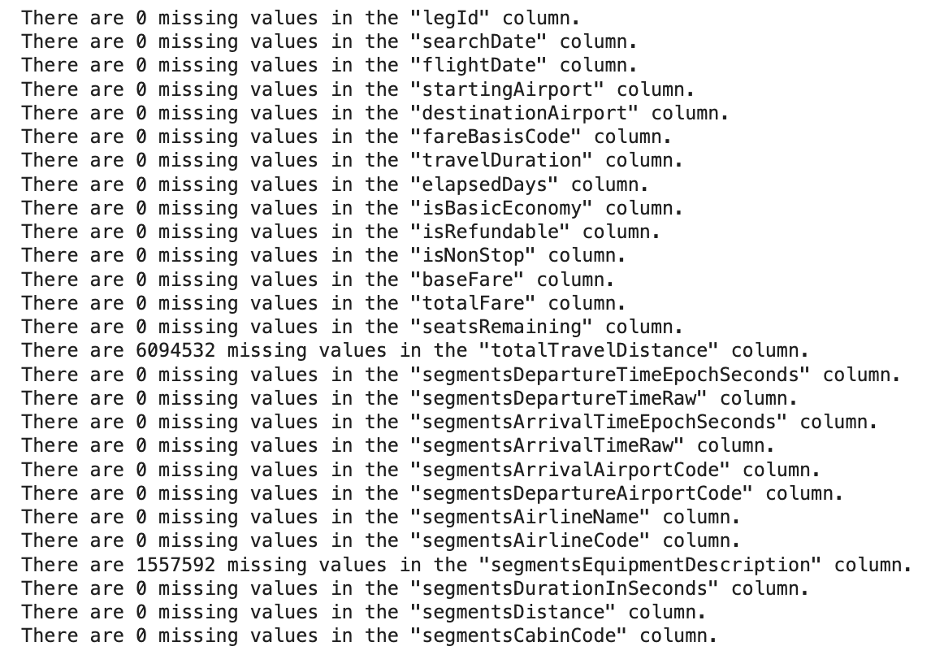
Exploratory Data Analysis
Distribution of fare ratio (total fare/base fare) across unique fare pairs, highlighting variations in additional costs and pricing structures.
Distribution of flights by destination airport, showing variations in flight volume across different locations, with LAX having the highest number of flights.
Summary of missing values in dataset columns, highlighting significant gaps in totalTravelDistance and segmentsEquipmentDescription.
Notes:
Note: For the number of flights per destination airport, probably should mention that a distribution was also produced by starting airport (instead of destination airport), but, naturally, this distribution only barely differed from the one shown above.

Slide 7
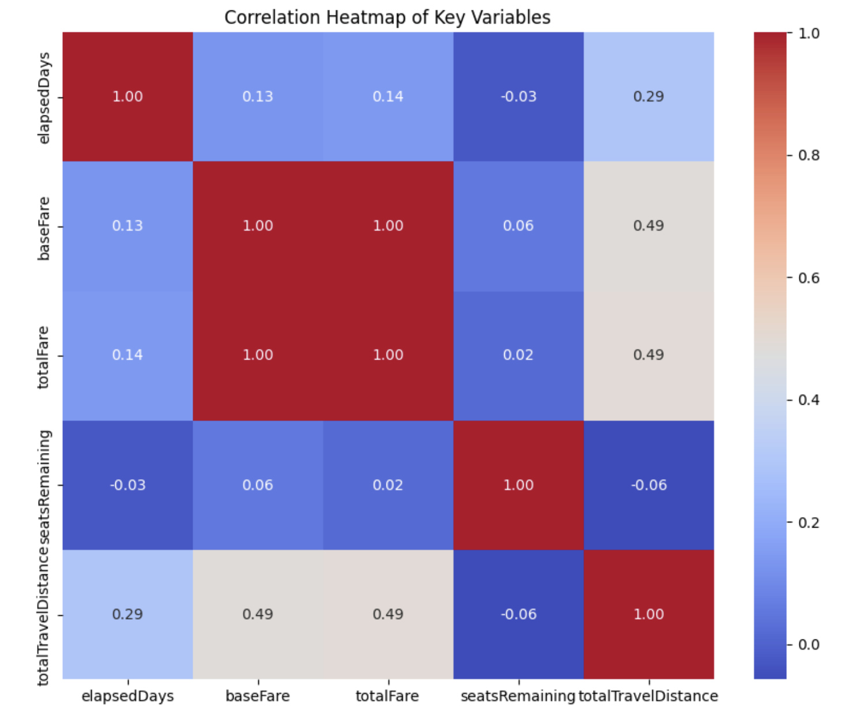
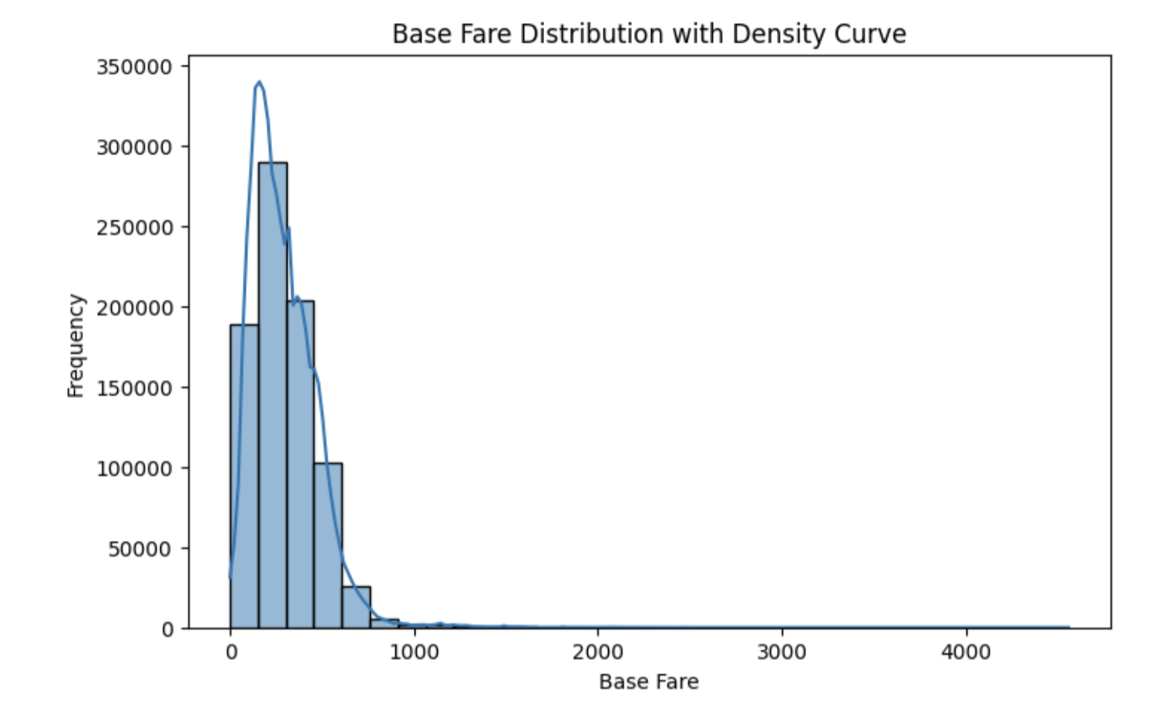
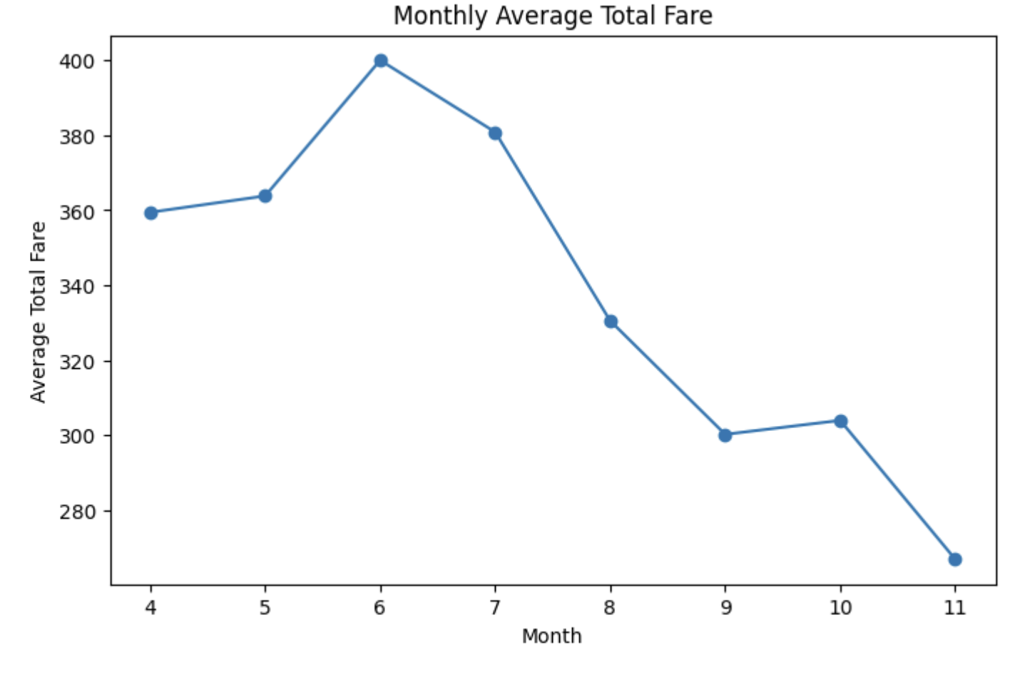
Exploratory Data Analysis
Histogram displays the frequency of flights by their base fare. The overlaid density curve provides a smooth approximation of the base fare distribution. The distribution is right-skewed (positively skewed), indicating more lower fares with fewer high-priced outliers.
A color-coded matrix of correlation coefficients among variables like elapsedDays, baseFare, totalFare, seatsRemaining, andtotalTravelDistance.
A line chart of the average total fare by month, illustrating how fares fluctuate over time
Notes:
Note: Probably should mention that these are the plots where we started to require sampling (as opposed to the previous plots, which were run on the entire dataset)

Slide 8
Feature Engineering
Data Cleaning: Removed rows with missing flightDate to ensure accurate day-of-week (DOW) extraction.
Justification: Ensures time-based trends can be analyzed properly.
Feature & Target Selection:
Features: elapsedDays, totalTravelDistance, seatsRemaining, and extracted DOW.
Targets: baseFare, totalFare.
Justification: Captures key predictors of airfare while incorporating time-related trends.
Data Transformation:
Cast numerical features and targets to float for model compatibility.
Extracted DOW from flightDate and cast to int for categorical encoding.
Justification: Ensures consistency in data types and enhances model interpretability.
Train-Test Split:
Split dataset into 75% training, 25% testing.

Slide 9
Model Training
Linear Regression
Random Forest Regression
XGBoost

Slide 10
Linear Regression
Why?
Simple & Interpretable: Linear Regression provides a straightforward approach to modeling airfare trends, offering clear insights into how different factors impact prices.
Effective for Continuous Data: Can exploit potentially linear relationships among numerical features like flight distance, travel time, and base fare.
Suitable Baseline: Serves as a strong benchmark to evaluate more complex models like XGBoost and LightGBM, helping assess the benefits of non-linear approaches.

Slide 11
Random Forest Regression
Why?
Robust & Versatile: Random Forest Regression leverages multiple decision trees to capture complex, non-linear relationships in airfare pricing while avoiding overfitting.
Handles Mixed Data & Missing Values: Efficiently processes both categorical (airlines, travel classes) and numerical (flight duration, distance) features without extensive preprocessing.
Feature Importance & Stability: Provides insights into key pricing factors while maintaining stable performance, even with noisy or imbalanced data.

Slide 12
XGBoost
Why?
Powerful & Regularized: XGBoost’s built-in L1/L2 regularization prevents overfitting, making it well-suited for volatile airfare trends.
Handles Complex Data: Effectively processes both categorical (airlines, departure locations) and numerical (flight distance, duration) features while managing missing data automatically.
Optimized Performance: Uses second-order Taylor approximation for faster convergence, with hyperparameter tuning to maximize accuracy and interpretability.

Slide 13
Preliminary Efforts
Training
Train models with sklearn, using only a 1% sample of the dataset
Use only the simplest features (i.e., those which do not feature engineering) as inputs: elapsedDays, totalTravelDistance, seatsRemaining
Use baseFare as the target variable
Evaluate/compare model performances using Mean Squared Error (MSE)
Linear regression model adopted as a strong baseline
Tune hyperparameters over a very small grid
Results
With default hyperparameters, both Random Forest Regression and XGBoost models improved on baseline performance, with the Random Forest Regression model outperforming XGBoost.
Hyperparameter tuning was applied to the model most favored (Random Forest Regression) under default hyperparameters
Resulting optimized model was then analyzed further

Slide 14
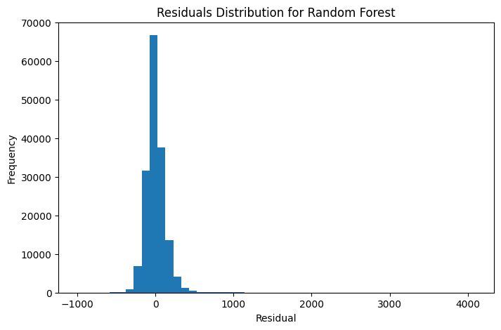
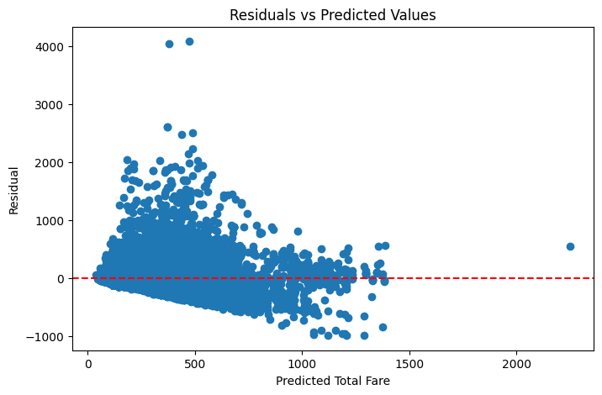
Further Analysis Details
Residual Analysis
Feature Importances
elapsedDays: 0.0230
totalTravelDistance: 0.8668
seatsRemaining: 0.1102
Provides further insights into which features may be worth discarding/preserving in the future; useful for computational cost management

Slide 15
Formalized Approach
Training
Extend to the entire dataset using PySpark
Gradually introduce new features so that impacts on runtime may be gradually assessed
New features introduced thus far: day of week (DOW)
Adopt an optimized trivial predictor (constant target mean prediction) as an additional baseline model

Slide 16
Summary of Model Performances
Model | Test RMSE*
Baseline (Constantly Predicting Target Mean) | 183.15
Linear Regression | 157.68
Random Forest Regression | 153.63
XGBoost | 147.80
*Corresponding values on the train set were generally comparable across all models, providing assurance against overfitting

Slide 17
Conclusion
After extending preliminary efforts to a more formalized approach, the best-performing model ended up being an XGBoost model.
While we managed to consistently achieve improvements on baseline performances, a model which could be even remotely reliable from an intuitive perspective has yet evaded us. We anticipate progress towards this goal to largely be a matter of time. Specifically, we hope to extract many other features of interest from our dataset which have not yet been incorporated in our model, ideally at the expense of a relatively manageable uptick in runtime. Moreover, we hope that further hyperparameter tuning will offer additional improvement on our model’s predictive capacity.

Slide 18
Next Steps
Model Optimization & Hyperparameter Tuning
Train a LightGBM model on the dataset to see if it can improve on performance thresholds obtained thus far
Further fine-tune XGBoost and Random Forest Regression for better accuracy
Leverage Bayesian optimization and grid search for parameter tuning
Add More Features without Exacerbating Computational Demand
Remaining categorical input features: startingAirport, destinationAirport, isEconomy, isNonstop
Remaining numerical input features: flightDuration
Extending to a multiple regression model: predicting (baseFare, totalFare)
Interpretability & Explainability
Use SHAP (Shapley Additive Explanations) to analyze key pricing factors.
Compare feature importance across different models for deeper insights.
Model Deployment & Real-World Testing
Develop a real-time airfare prediction tool for practical applications.
Validate model predictions against live airfare data to measure performance.

Slide 19
References
Biswas, P., Chakraborty, R., Mallik, T., Chakraborty, R., Uddin, S. I., Saha, S., Das, P., & Mitra,
S. (2022). Flight price prediction: A case study. International Journal for Research in Applied
Science & Engineering Technology (IJRASET), 10(VI).
Groves, W., & Gini, M. (2013). An agent for optimizing airline ticket purchasing. In Proceedings of the 2013 International Conference on Autonomous Agents and Multi-agent Systems (AAMAS).
Tziridis, K., Kalampokas, T., Papakostas, G. A., & Diamantaras, K. I. (2017). Airfare prices
prediction using machine learning techniques. In 2017 25th European Signal Processing
Conference (EUSIPCO).
Wong, D. (2022). Flight prices [Data set]. Kaggle.
https://www.kaggle.com/datasets/dilwong/flightprices

